Slide 1
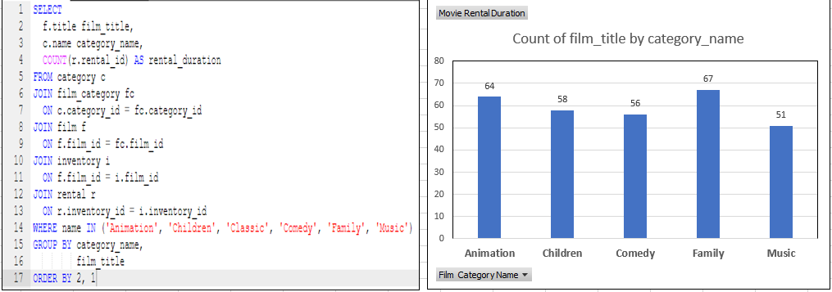
We want to understand more about the movies that families are watching. The following categories are considered family movies: Animation, Children, Classics, Comedy, Family and Music. Create a query that lists each movie, the film category it is classified in, and the number of times it has been rented out. Graph shows that out of the five categories, the most rented film with a rental count of 67 is the “Familhy Category”. While the “Music Category” has the least rental count of 51

Slide 2
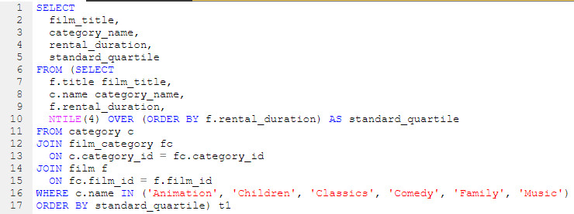
Q. Now we need to know how the length of rental duration of these family-friendly movies compares to the duration that all movies are rented for. Can you provide a table with the movie titles and divide them into 4 levels (first_quarter, second_quarter, third_quarter, and final_quarter) based on the quartiles (25%, 50%, 75%) of the rental duration for movies across all categories? A. In comparison the Family category is the longest rented films and has the longest duration across all four quarters.

Slide 3
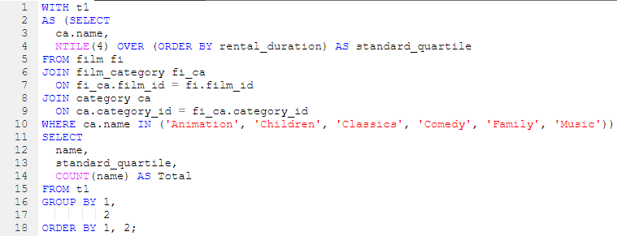
Q. Finally, provide a table with the family-friendly film category, each of the quartiles, and the corresponding count of movies within each combination of film category for each corresponding rental duration category. A. Graph shows the sum count across all categories are the similar, with a the count “family category’ as the highest.

Slide 4
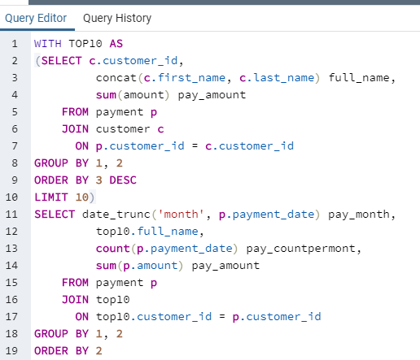
Q. We would like to know who were our top 10 paying customers, how many payments they made on a monthly basis during 2007, and what was the amount of the monthly payments. Can you write a query to capture the customer name, month and year of payment, and total payment amount for each month by these top 10 paying customers? A. For the month of April 7 out of 10 customers made their highest payments ranging from $72 -$100. While 3 out of 10 made their highest payment in the month of March ranging from $64.85-$86.83

